Slide 1
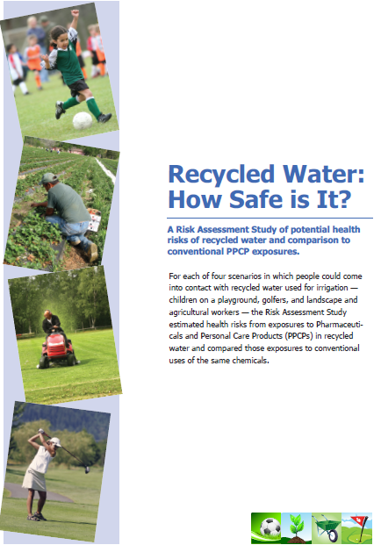


Improving Public Acceptance:
Communicating Risk in Ways Easily Understood by the Public
International Water Association
Barcelona, Catalunya
September 29, 2011
Notes:
Mark: Explain where we are in the process and why we are here today to brief our sponsor.
Periodically reviewed by Project Advisory Committee. Currently being reviewed until March
We are checking in with our sponsors to verify the information

Slide 2
Chemicals of Emerging Concern
PPCPs
New Resource
Dirty Water
Chemical Cocktail
Can we Trust you?
Kills Fish
Unsafe for Kids
Contaminants
Microconstituents
Notes:
Mark

Slide 3

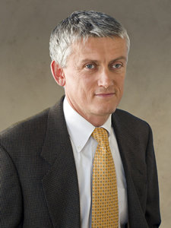
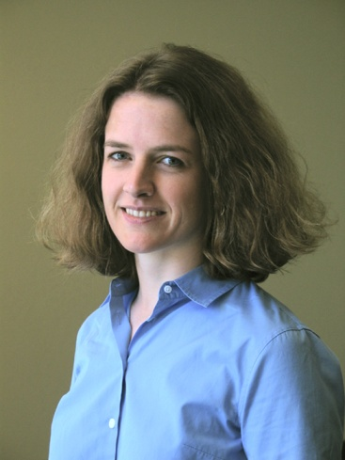
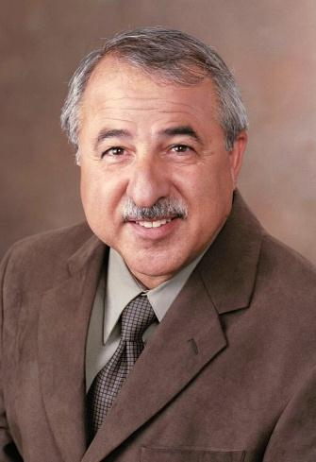
WRF-09-07:
Risk Assessment Study of PPCPs in Recycled Water to Support Public Review
Jean Debroux
Director
Advanced Technologies Group
Laura Kennedy
Principal
Kennedy/Jenks Consultants
Mark Millan
Principal, Data Instincts
Public Outreach Consultants
Notes:
Mark introduces Jean

Slide 4
Study Objectives - Literature Studies
Builds off of other Risk Assessment work
  Anderson, P. 2008; Cotruvo, et al. WRF-06-004; Drewes, et al. 2008 WRF 03-014; Drewes, et al. 2009 WRF-04-018; EPA. August 2009; EPHC. 2008; Kennedy/Jenks and Soller Environmental. 2010; Nellor, M. and J. Soller WRF-06-018; Schwab, et al. 2005; Snyder, et al. 2008; Snyder, et al. 2008 WRF 04-003; Snyder, et al. WRF 05-005; Rounds, et al. 2009; Ayscough, et al. 2000; Lubliner , et al. 2010; California State Water Resources Control Board. 2010
Focused on non-potable recycled water use

Slide 5
Objective of the Study
Utilize existing studies for occurrence and toxicity data
Focus on non-potable recycled water uses
Focus on pharmaceuticals and personal care products (PPCPs) in recycled water
Provide quantitative human health risk assessment results
Develop message delivery tools to communicate the results
What is the best way to impart this information?
Notes:
Jean: brief overview

Slide 6
Compounds of Interest
PPCP | Type of Substance | Common usage
Ibuprofen | Over the counter (OTC) pharmaceutical | Non-steroidal anti-inflammatory
Acetaminophen | OTC pharmaceutical | Analgesic
17-beta estradiol | Prescription pharmaceutical | Synthetic and naturally occurring hormone
Fluoxetine | Prescription pharmaceutical | Antidepressant
Caffeine | Ingredient in food and drink | Stimulant
Triclosan | Personal care product | Antimicrobial
Sulfamethoxazole | Prescription pharmaceutical | Antibiotic
N,N-Diethyl-meta-toluamide (DEET) | Personal care product | Insect repellant
Perfluorooctanesulfonic acid (PFOS) | Organic compound formerly used in common products | Fluorosurfactant
Bisphenol A | Organic compound used in common products | Various uses, primarily plastics manufacturing

Slide 7




Criteria for Compounds of Interest
Occurrence in recycled water
Toxicological relevance
Overlap with comparable chemical risks (if possible)
Recognizable by the public (if possible)

Slide 8
Acceptable Concentrations
Based on exposure and toxicity assessments
Concentrations that can be present in recycled water and not exceed the acceptable daily intake
If actual concentrations are less than acceptable concentrations, adverse health effects are unlikely

Slide 9

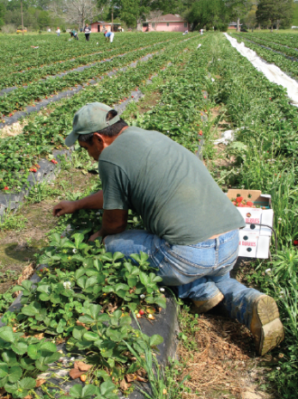
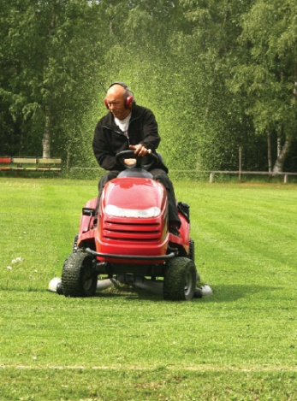

Non-Potable Exposure Scenarios
Parks, playgrounds, school yards: Children
Agricultural irrigation:
Agricultural workers
Freeway, highway, urban landscaping:
Landscape workers
Golf courses:
Golfers

Slide 10

Relative Risk Results
Provide context for exposures to PPCPs
Provide context for risks from recycled water
Used in development of communication tools

Slide 11
Relative Risks for PPCPs
 |  | Years of Non-Potable Recycled Water Exposure to Reach Common Exposure of Same PPCP for each Scenario
 | Comparison Exposure | Child on Playground | Agricultural Worker | Landscape Worker | Golfer
Ibuprofen | one Advil tablet (200 mg) | 67,000 | 28,000 | 8,600 | 26,000
17-beta estradiol | hormone replacement daily dose (0.5 mg) | 160,000 | 16,000 | 5,000 | 13,000
Fluoxetine | one dose (20 mg) | 220,000 | 83,000 | 26,000 | 91,000
Sulfamethoxazole | one dose (800 mg) | 1,900,000 | 220,000 | 69,000 | 1,100,000
PFOS | estimated daily adult intake from environmental factors (1,071 ng) | 46 | 5 | 1.5 | 29
Bisphenol A | estimated daily adult intake from food (13 ug) | 22 | 7.1 | 2.2 | 8.9
DEET | one application of DeepWoods Sportsman Off! to arms, hands, and lower legs | 110,000,000 | 85,000,000 | 26,000,000 | 190,000,000
 | (110,000 mg for child, 450,000 mg for adult )
Triclosan | an adult washing hands for 30 seconds with anti-bacterial soap (91 mg) | 17,000 | 7,600 | 2,400 | 6,600
Acetaminophen | one extra-strength Tylenol tablet (500 mg) | 3,000,000 | 350,000 | 110,000 | 1,700,000
Caffeine | one cup of coffee (100 mg) | 410,000 | 44,000 | 14,000 | 250,000

Slide 12
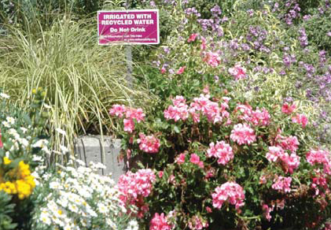
Conclusions of Risk Assessment
PPCPs in recycled water are not likely to result in adverse health effects for non-potable uses
Exposure to PPCPs in recycled water is much less than common daily exposures to PPCPs

Slide 13
Communicating the Results
All outreach items were tested in Focus Groups
Community Outreach Materials: Backgrounders, brochures, fact sheets and FAQs
Key Messages
All will be made available via WateReuse outlets; hard copies and Public internet site – AThirstyPlanet.com
Notes:
Mark: Periodically reviewed by Project Advisory Committee. Currently being reviewed until March
We are checking in with our sponsors to verify the information.

Slide 14
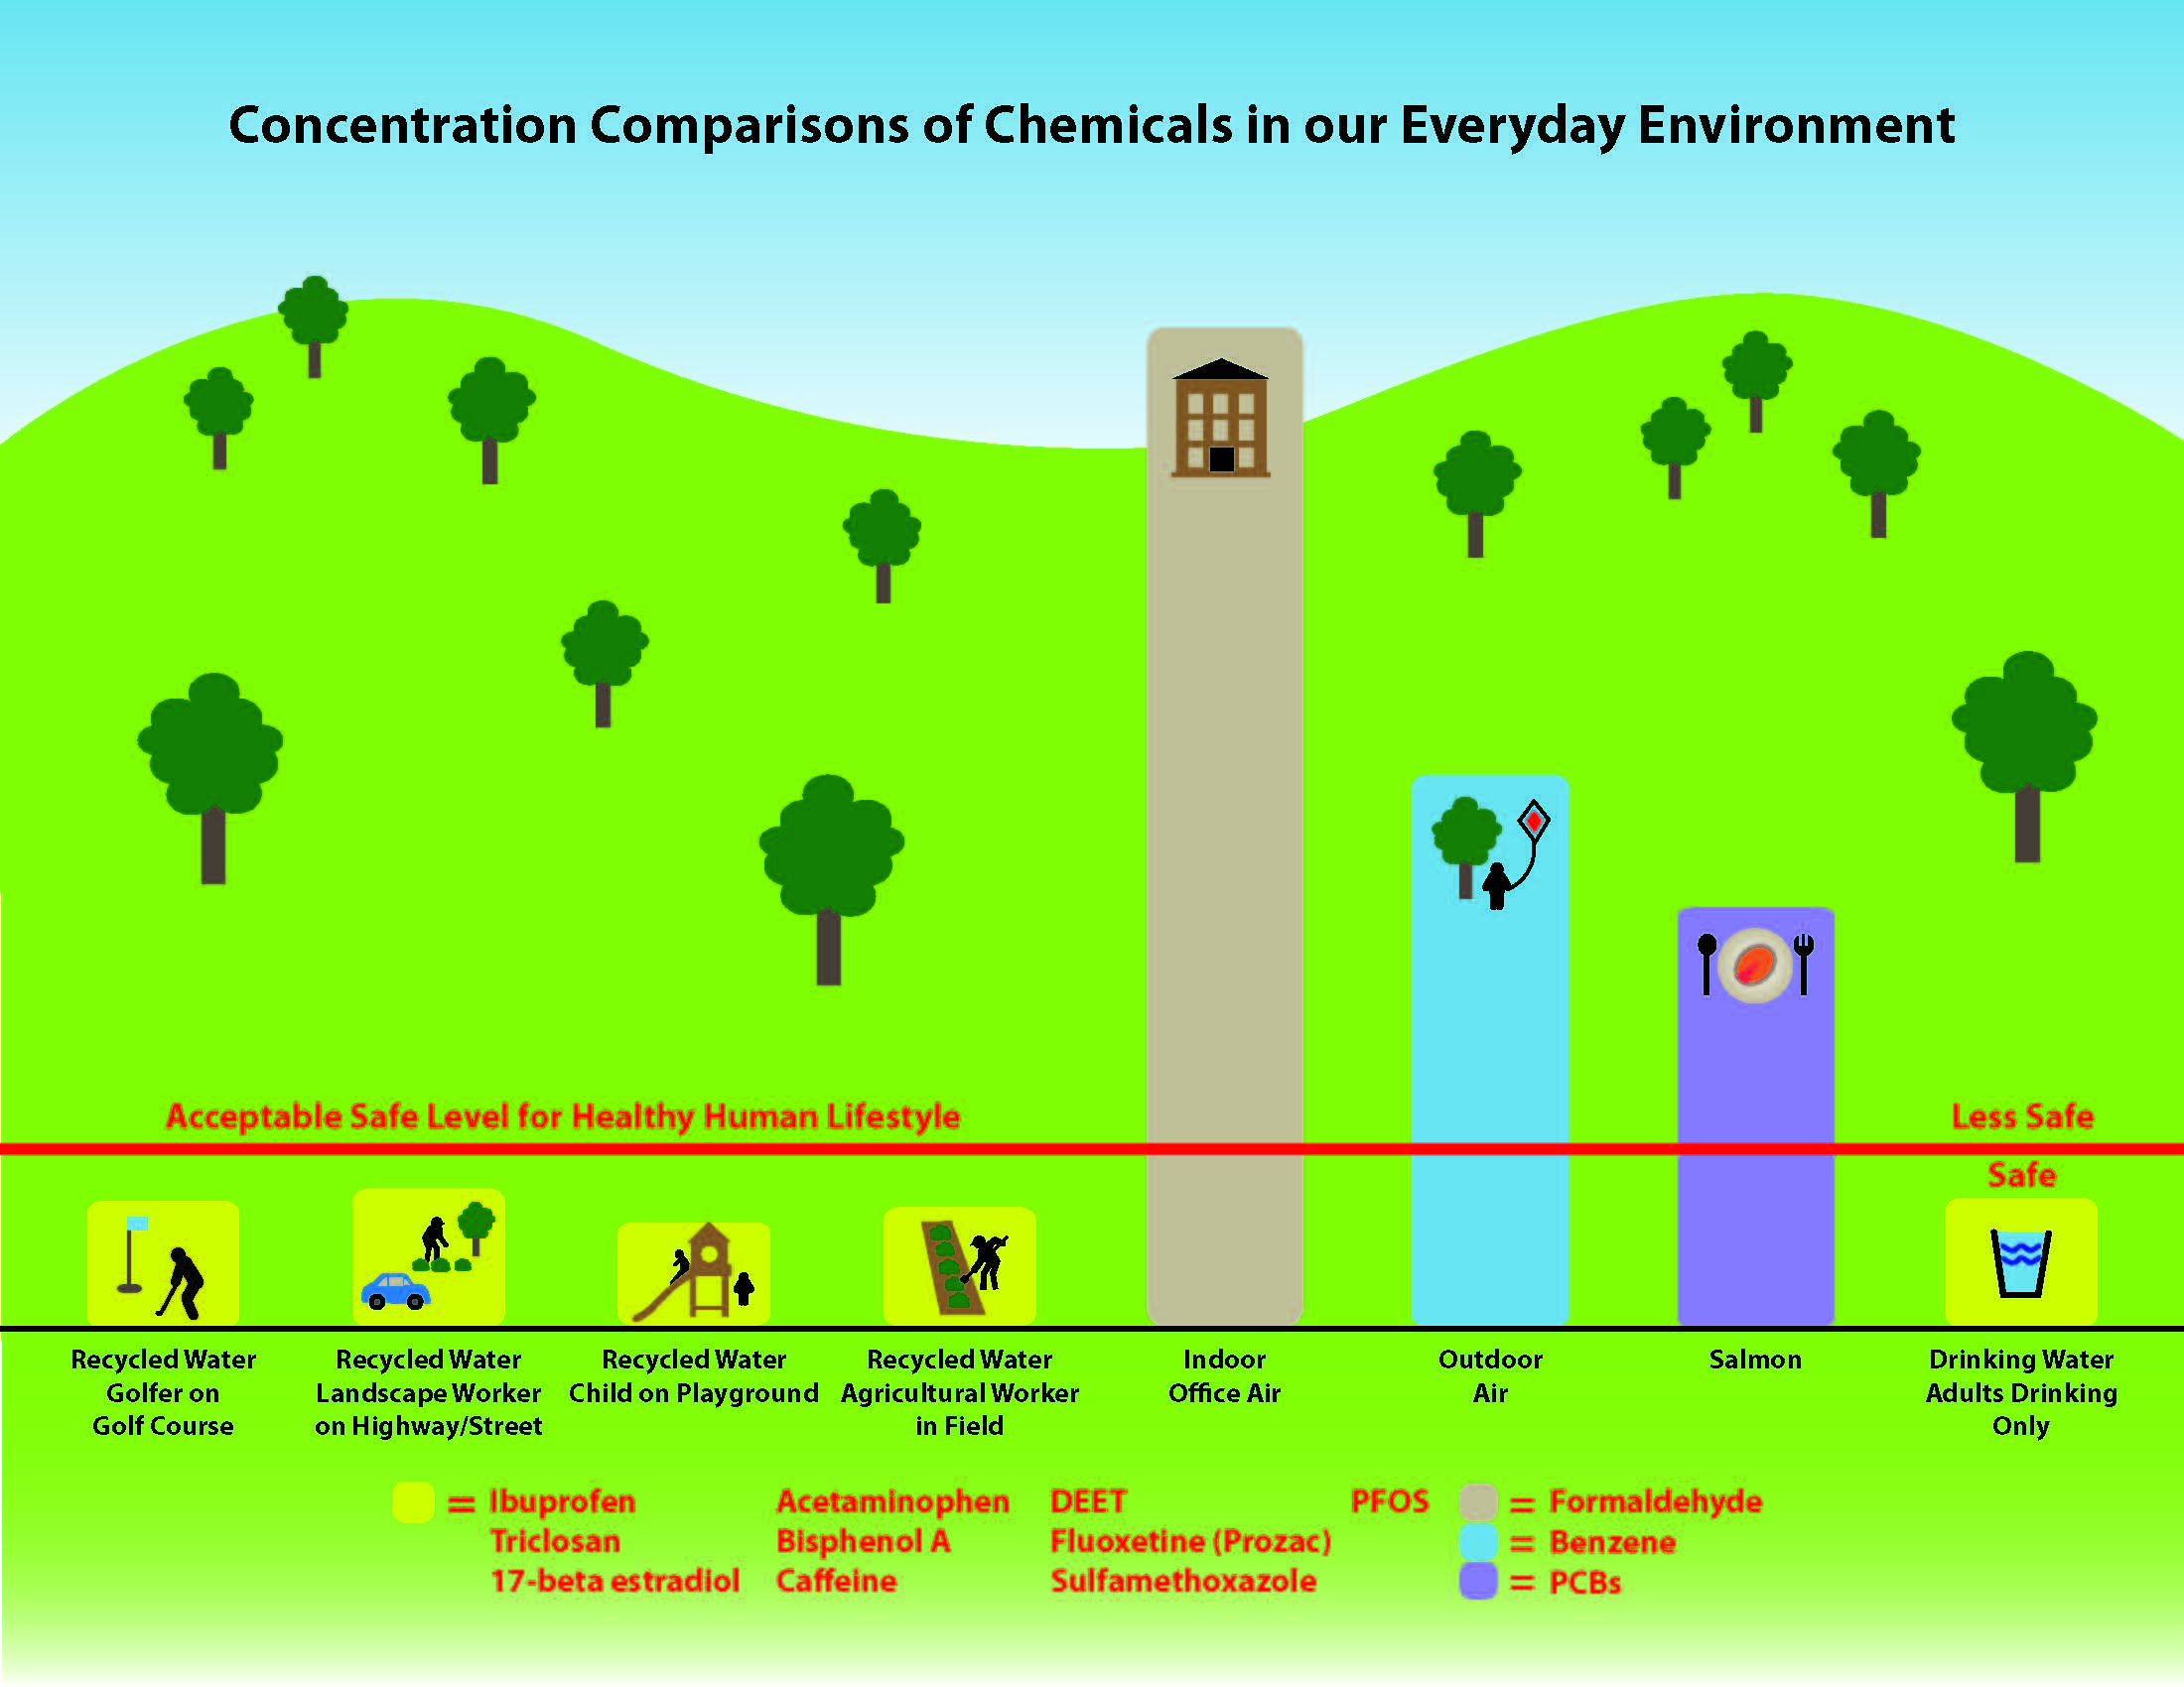
Key Message

Slide 15
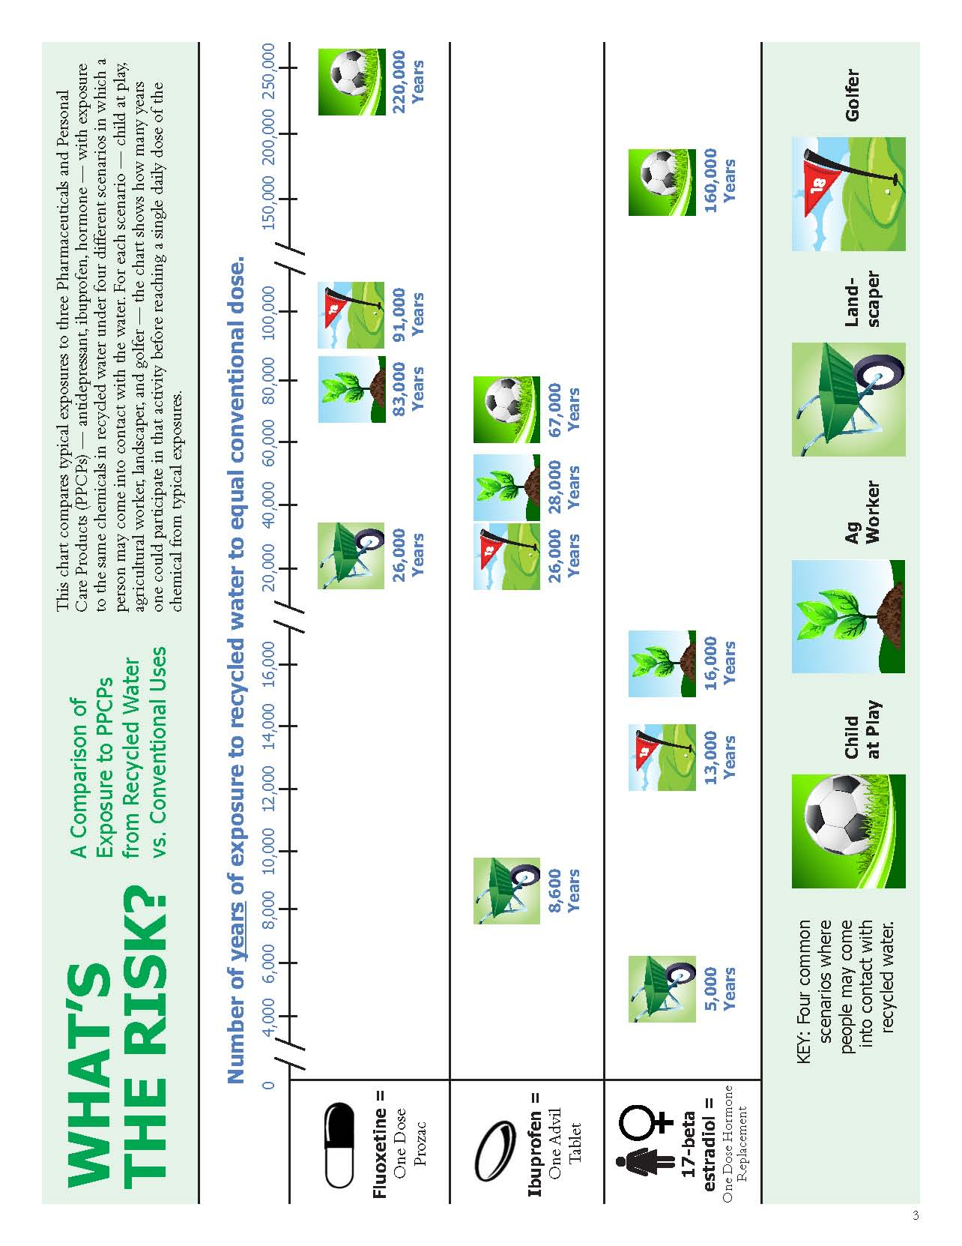
Notes:
The concepts, as a whole, were favorably received and imparted positive impressions of recycled water and its benefits. While preferences varied by market, each of the concepts received at least one mention as a compelling/relevant idea. Respondents’ ability to grasp the examples and any provided data seemed to influence their preferences and their ability to relate to it.
agricultural worker toiling for 28,000 to receive the equivalent of a single dose of ibuprofen clearly telegraphed the low risk associated with coming into contact with recycled water.

Slide 16
Non-Potable Exposure Scenarios
Child at play
Agricultural worker
Urban landscaper
Golfer

Slide 17
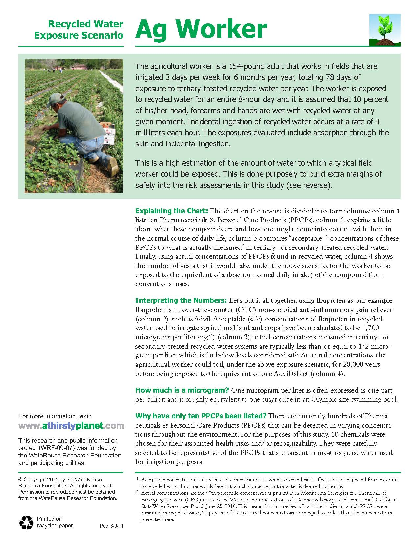
Notes:
The golfer was the next most compelling exposure scenario as respondents could relate to the subject because they, or their spouses, were golfers. However, a few golfers did not feel this example was entirely believable or compelling because golf courses tend only to be wet enough for human exposure to recycled water early in the morning, which is a small part of the day thereby hindering the credibility of the scenario. o Though not as relatable or compelling as the child or golfer, the landscaper was thought to be believable and credible because of the perceived amount of recycled water to which this person might be exposed. Several felt that the landscaper seemed the most likely of the users to have frequent/daily contact with recycled water. In spite of generally positive reactions to this example, a few Sunnyvale respondents felt this concept is missing a basis of comparison with respect to the sentence, “This is a high estimation of the amount of water to which a typical landscape worker could be exposed.” And similar to the other exposure scenarios, questions arose regarding how this individual incidentally ingested the recycled water.

Slide 18
Notes:
The golfer was the next most compelling exposure scenario as respondents could relate to the subject because they, or their spouses, were golfers. However, a few golfers did not feel this example was entirely believable or compelling because golf courses tend only to be wet enough for human exposure to recycled water early in the morning, which is a small part of the day thereby hindering the credibility of the scenario. o Though not as relatable or compelling as the child or golfer, the landscaper was thought to be believable and credible because of the perceived amount of recycled water to which this person might be exposed. Several felt that the landscaper seemed the most likely of the users to have frequent/daily contact with recycled water. In spite of generally positive reactions to this example, a few Sunnyvale respondents felt this concept is missing a basis of comparison with respect to the sentence, “This is a high estimation of the amount of water to which a typical landscape worker could be exposed.” And similar to the other exposure scenarios, questions arose regarding how this individual incidentally ingested the recycled water.

Slide 19
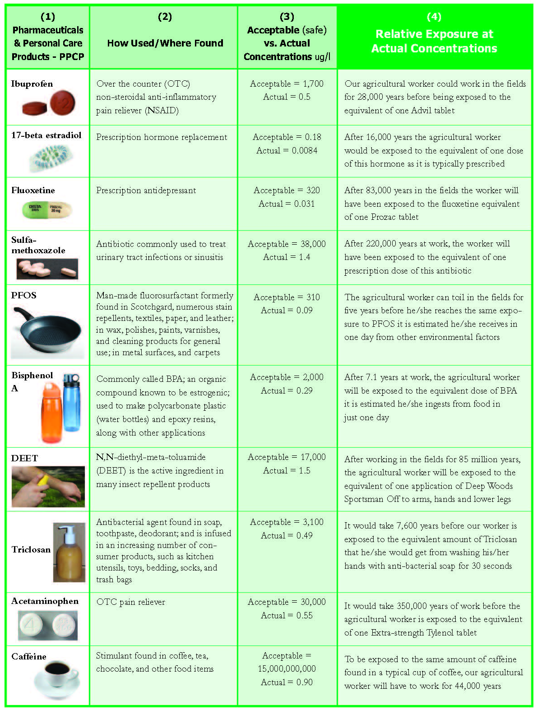
Notes:
The research revealed that the Sunnyvale respondents were considerably more concerned about the positive impact recycled water use could have on the environment and in their communities than their Riverside counterparts who appeared somewhat nonplussed by the use of recycled water in their area and its potential environmental benefits (i.e., protecting fish species by maintaining flows in natural waterways).

Slide 20
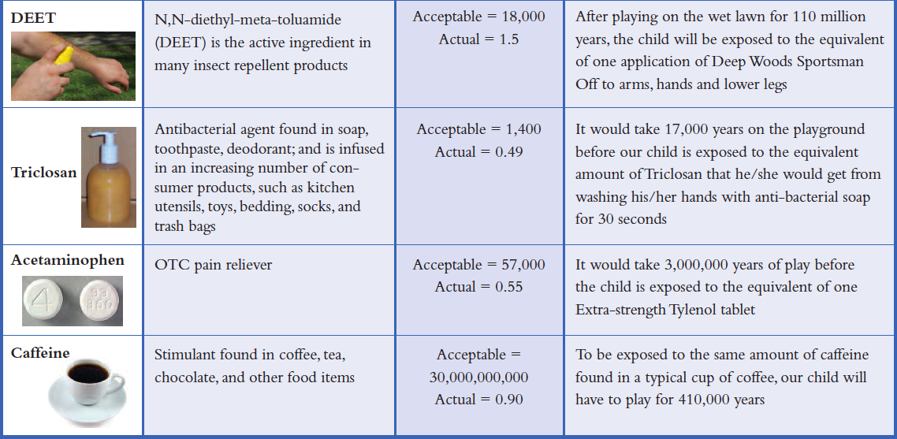
Communicating the Results

Slide 21
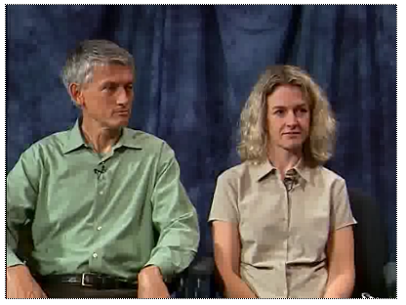
Communicating the Results
Brief Video: Putting the “Risk into Perspective”
Features two leading scientists who have been researching recycled water safety concerns for years

Slide 22
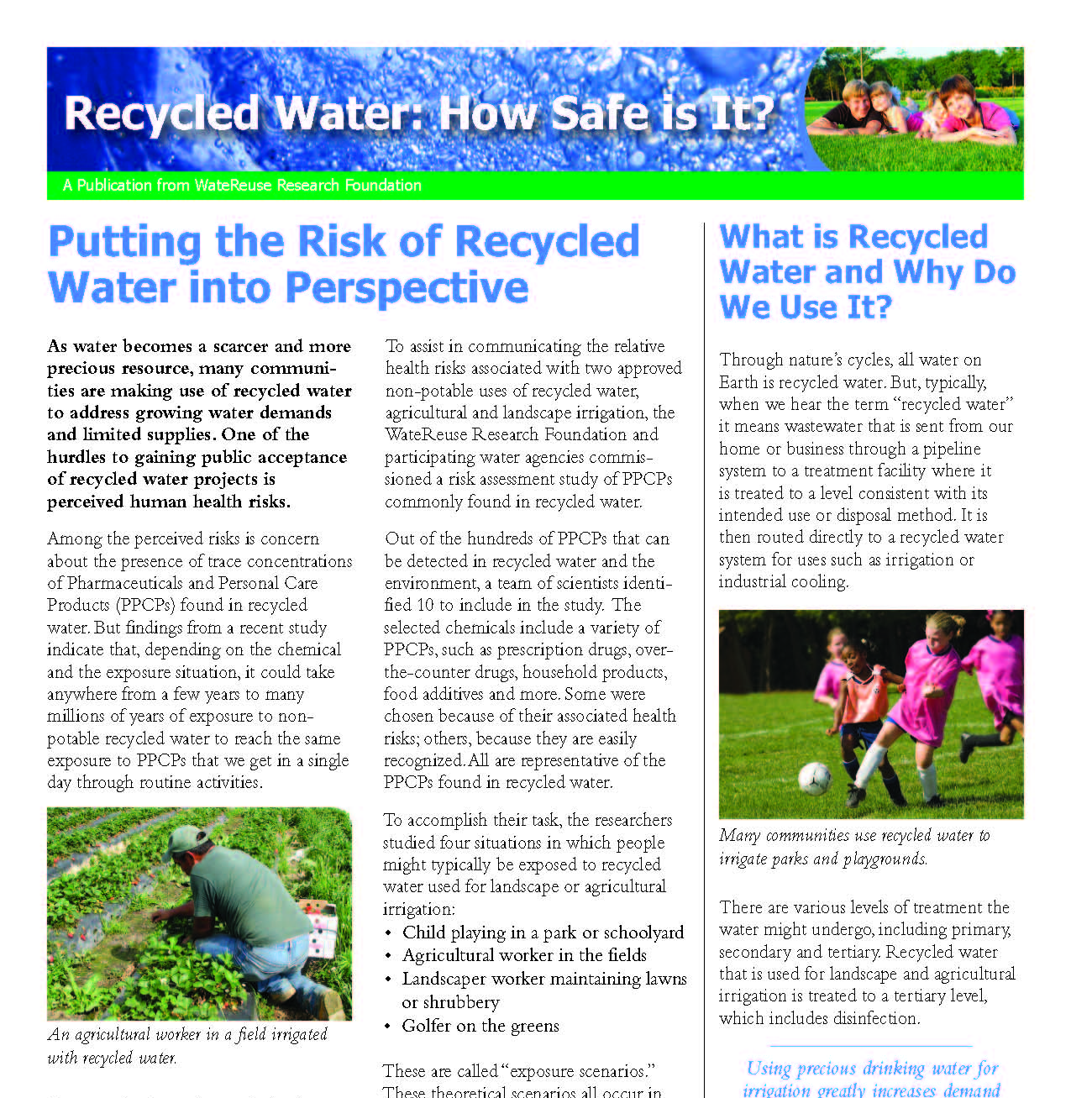
Communicating the Results

Slide 23
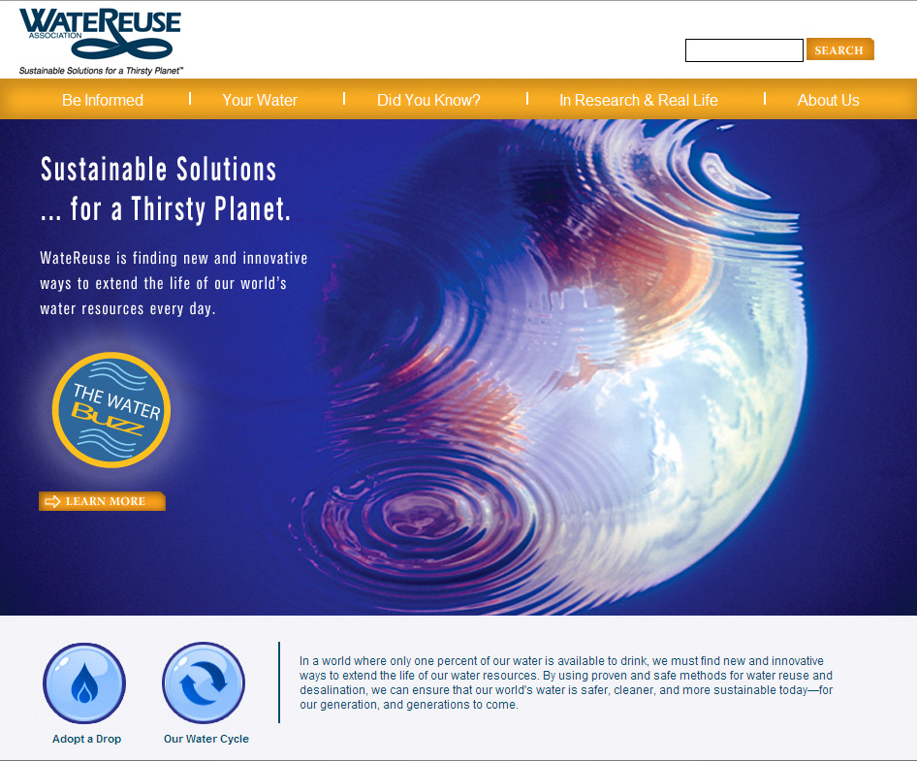
Notes:
Under the direction of the E&O Committee - Krome Communications developed a public website that will serve as an information hub for the general public and “non-industry” audiences. This should appeal to a wide range of interests including, schools, parents, students, landscapers, environmental interests, stakeholders, opinion leaders, academia, and members of the media.

Slide 24

Best Opportunity for Message Delivery – is One on One Interviews
This Methodology Gathers input to assess issues and concerns for various uses;
Hear specific perceptions and views
Consider what potential users may need
Consider best outreach approach
Assess rate sensitivity

Slide 25
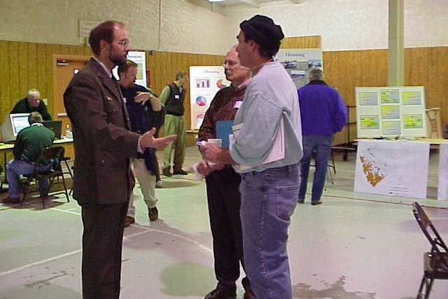
Methodology – How it works
Establishes trust and begins an open dialog
A valuable tool in providing opportunities for project teams and community leaders to learn –
Build relationships by putting a “face” on the project
Gain trust with project opponents
Allows team to educate
potential users and others
Create recycled water demand
without “selling”
Notes:
Reclaimed Water Customer Information Program
Create dedicated web pages on the King County web site for potential customers and final customers
Develop a brochure or one-page fact sheet covering the steps to participate in the program
Keep potential customers routinely informed during the long process of project implementation by developing an e-mail broadcast group dedicated to potential customers. If you routinely provide them with updates, schedule information, etc., you will minimize the occurrence of misinformation, rumors and uncertainties about project status.
For those customers concerned about water rights, advise them of their options, or guide them toward existing Trusts where their water rights can be banked, sold or retained in some way.

Slide 26
Methodology – How it works
The In-depth interview process
Uses standardized discussion guide
Using selection criteria, create contact list(s)
  Potential user types; Residential, Recreational playing fields, Agricultural, Industrial, and Commercial Landscapers
  Other segments of interest; Electeds, Opponents, NIMBYs
Meet at time and place convenient to interviewee
  Their place of business, or in the field
  Some interviews occur on telephone

Slide 27
What we typically hear…
Water quality concern in relation to public safety (especially children)
Concern for health and environmental effects of pathogens and pharmaceuticals
Most express a willingness to participate in the program
View as environmentally responsible to do so
Notes:
While we were working on finalizing the message delivery tools materials – In May, June and July I used the materials on one-on-ones in two projects. One was up in King County the other with the SFPUC on their evaluation for RW use on the eastside of San Francisco. I introduced the materials while in one-on-one in-depth interviews (26 in SF) (26 in Seattle area). The uses were broad; landscape irrigation, golf course, agricultural, parks & playgrounds.
In each and every case, when water quality concerns came up and I pulled out the materials, there was a sense of relief and satisfaction with the information provided. It mitigated the kinds of discussions we use to be in. Because the concept is so easy to understand, it instantly dispels that unknown fear. “Oh, 67,000 years, …well never mind.”

Slide 28
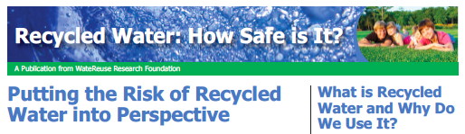
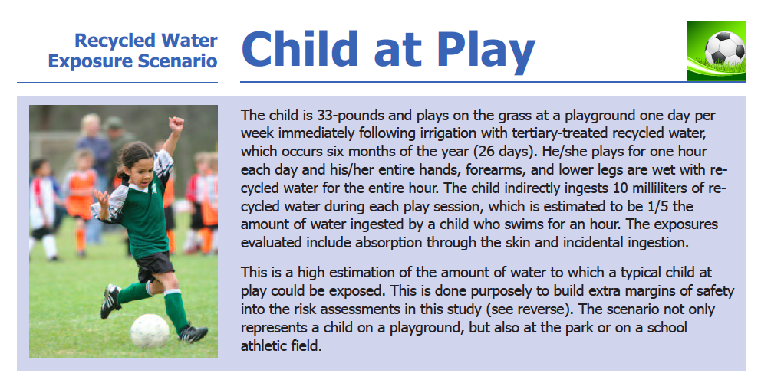

Slide 31
Most effective time to introduce these new materials is when the questions of water quality arises
Introduce the materials while in one-on-one conversations
Address unique uses, questions and concerns ; landscape irrigation, golf course, agricultural, parks & playgrounds.
When water quality concerns come up - point out findings from the Risk Assessment study and provide materials

Slide 32
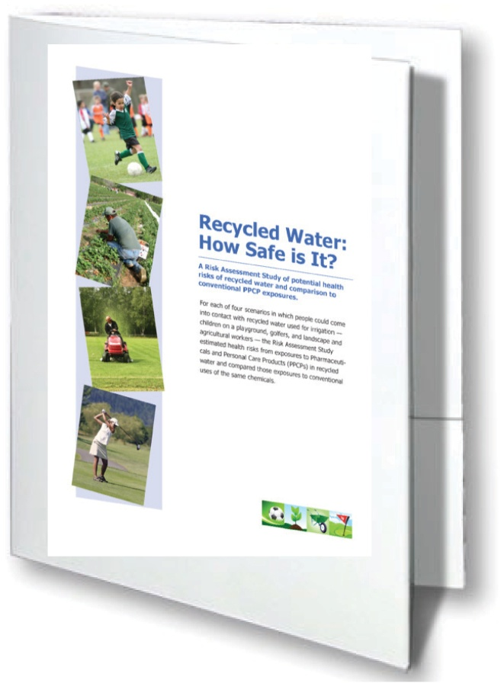
Reserve a Copy of the PPCP Communications Toolkit Today!
The PPCP Communications Toolkit Includes:
A four page illustrated color brochure titled Recycled Water: How Safe is It? which puts the risk of recycled water into perspective for the general public
Four double-sided flyers that explain estimated health risks from pharmaceuticals and personal care products for children on the playground, golfers, and landscape and agricultural workers
A 12 minute DVD, which synthesizes the results of the Risk Assessment Study.
www.watereuse.org/catalog/toolkit

Slide 33
Communicating in a way that is easily understood
www.athirstyplanet.com
www.watereuse.org
Notes:
Mark: The URL address for this new site is: www.athirstyplanet.com and is NOW available for all WRA members to link to form their web site – there by spreading the word and availability of this great information.

